Slide 1

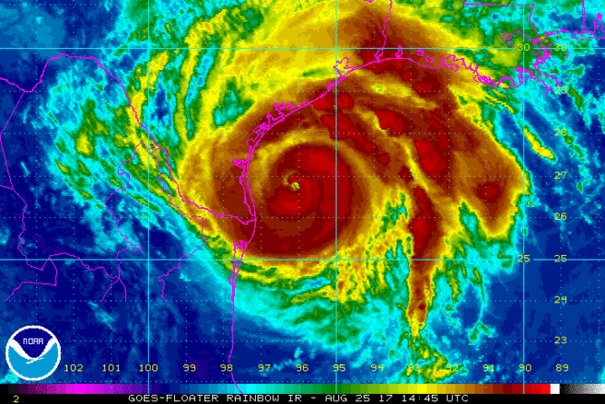
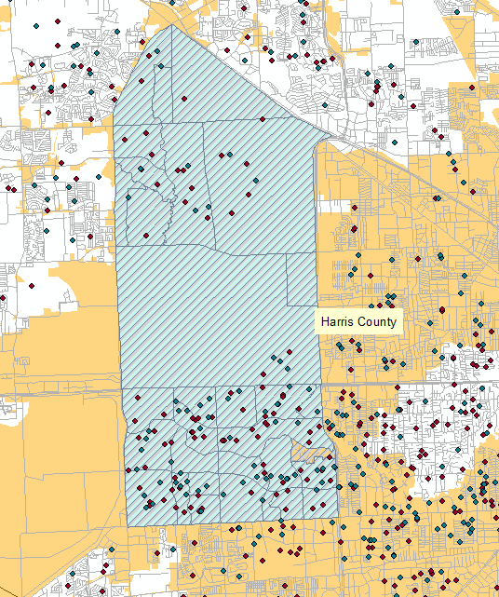
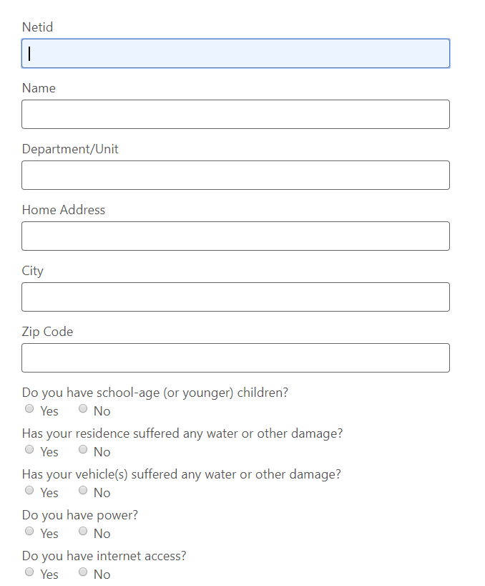
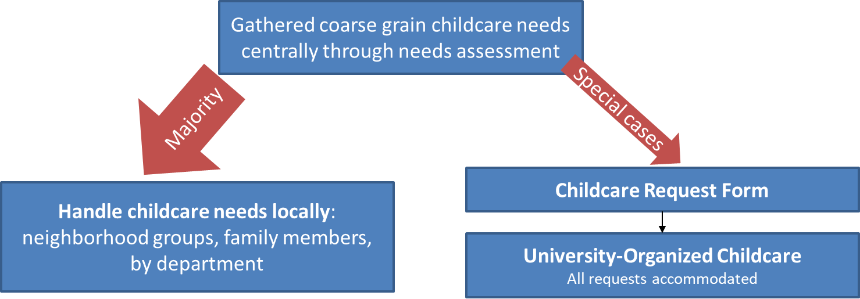
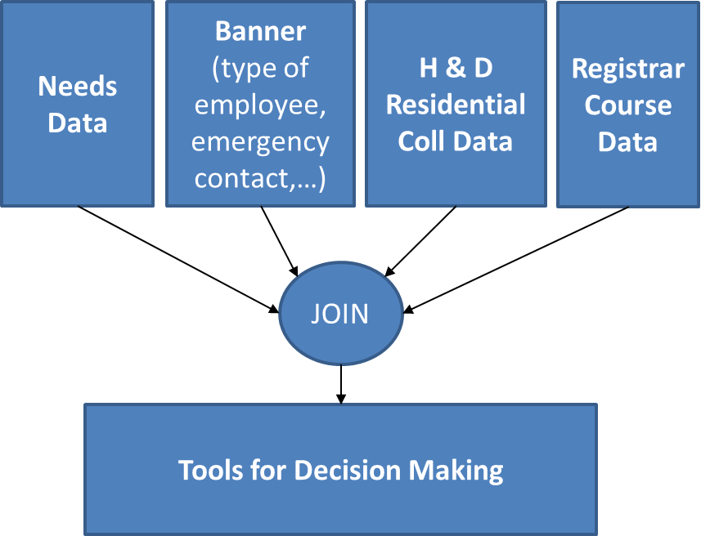
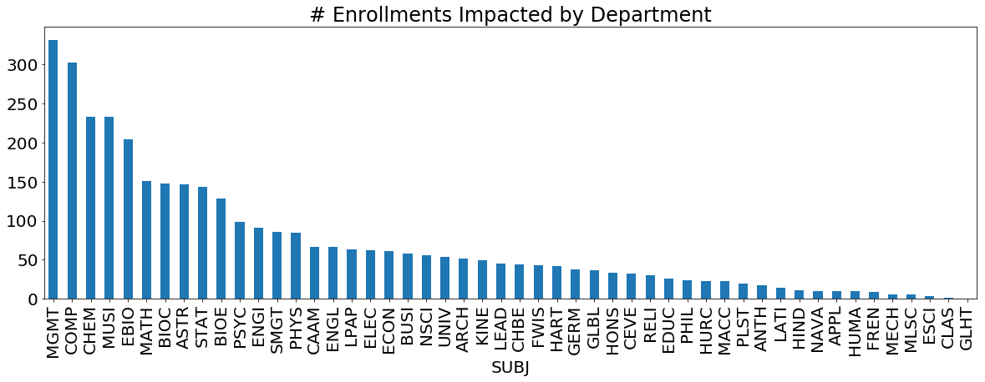
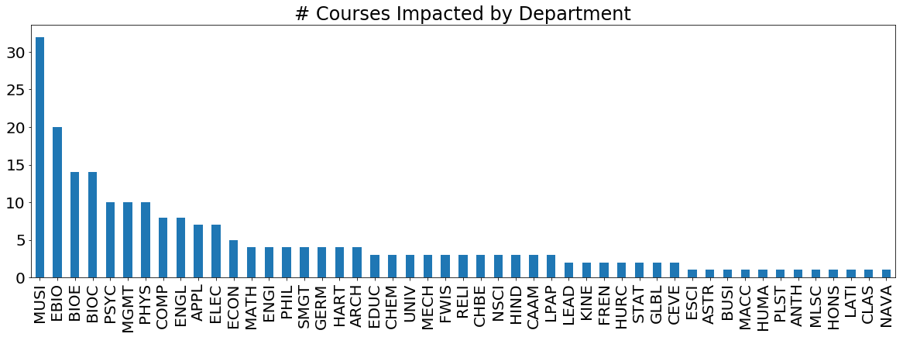
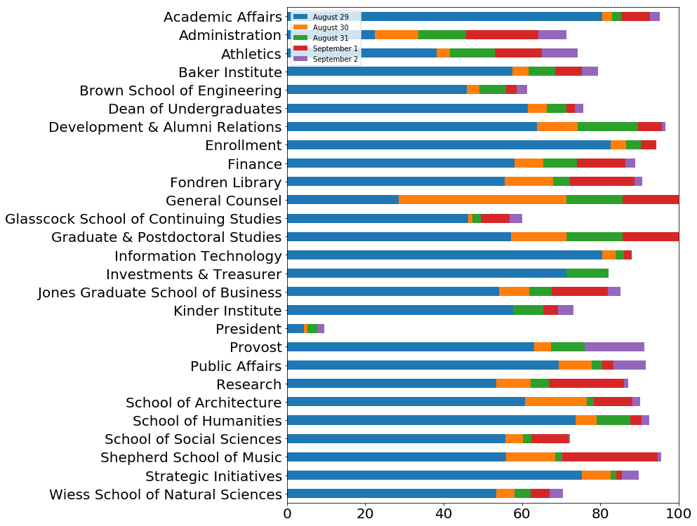
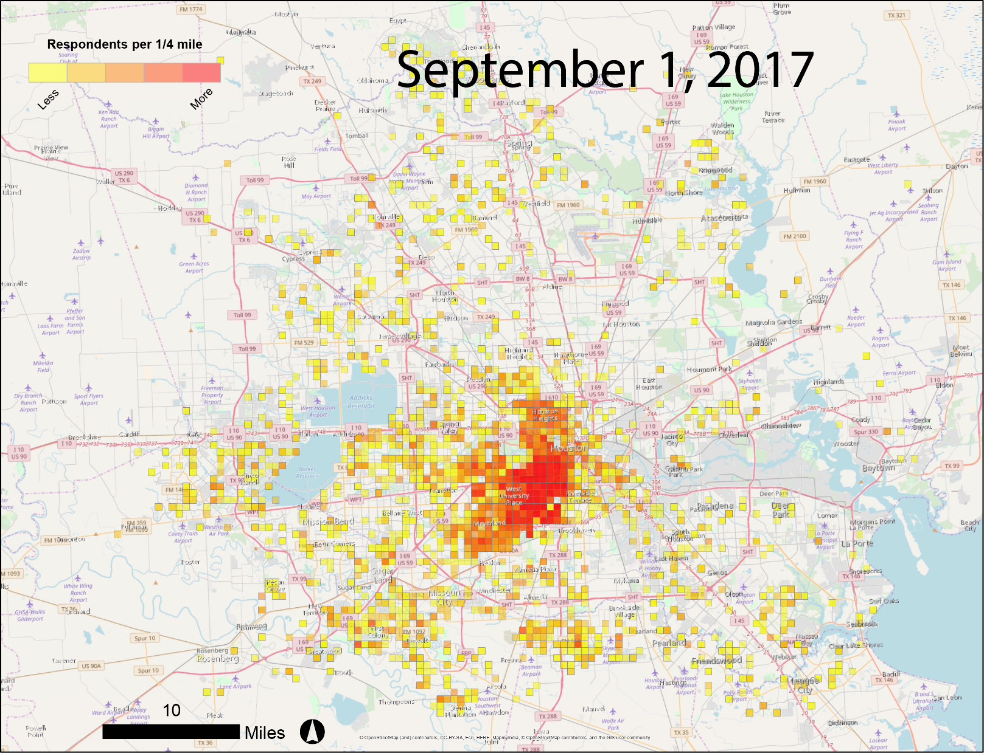
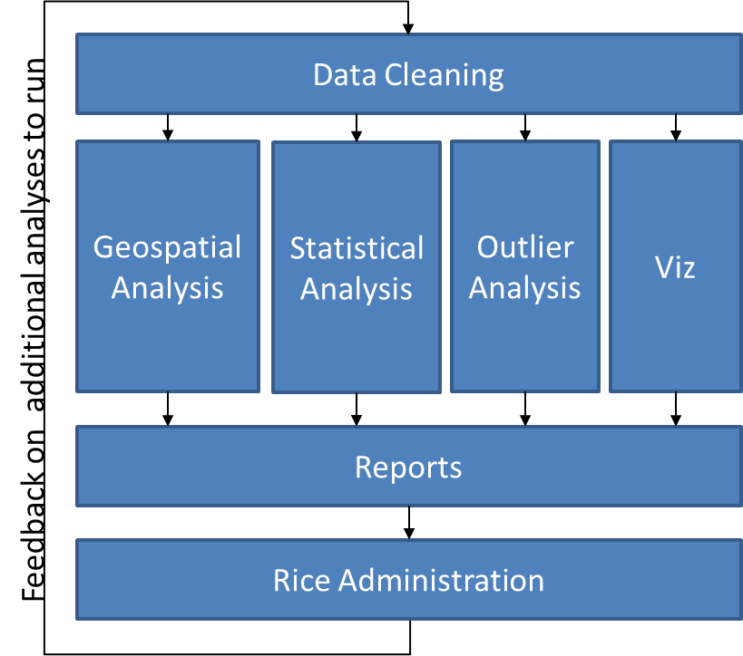
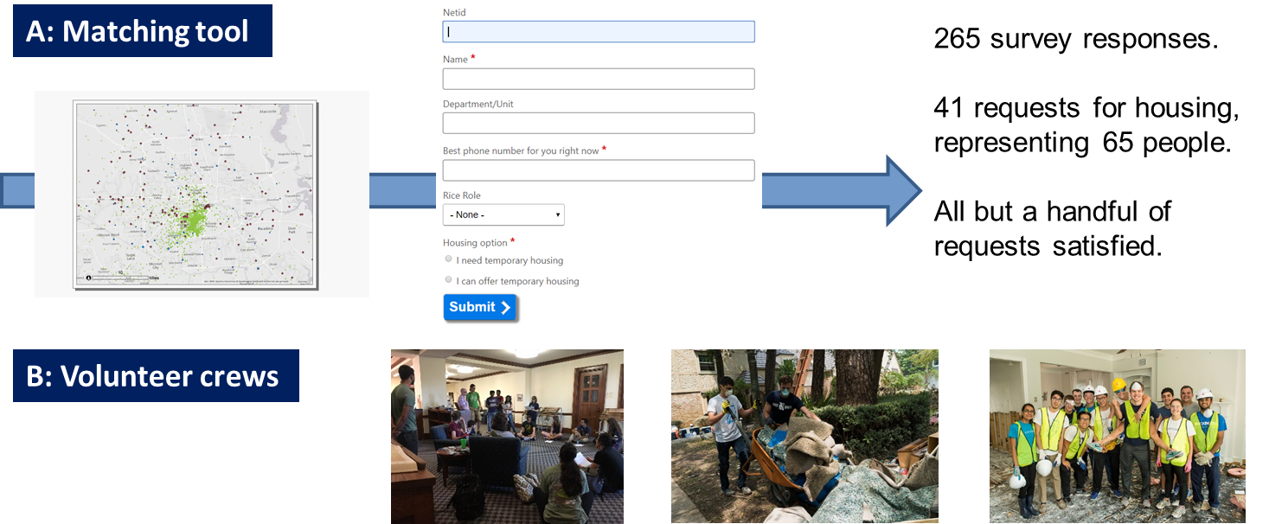
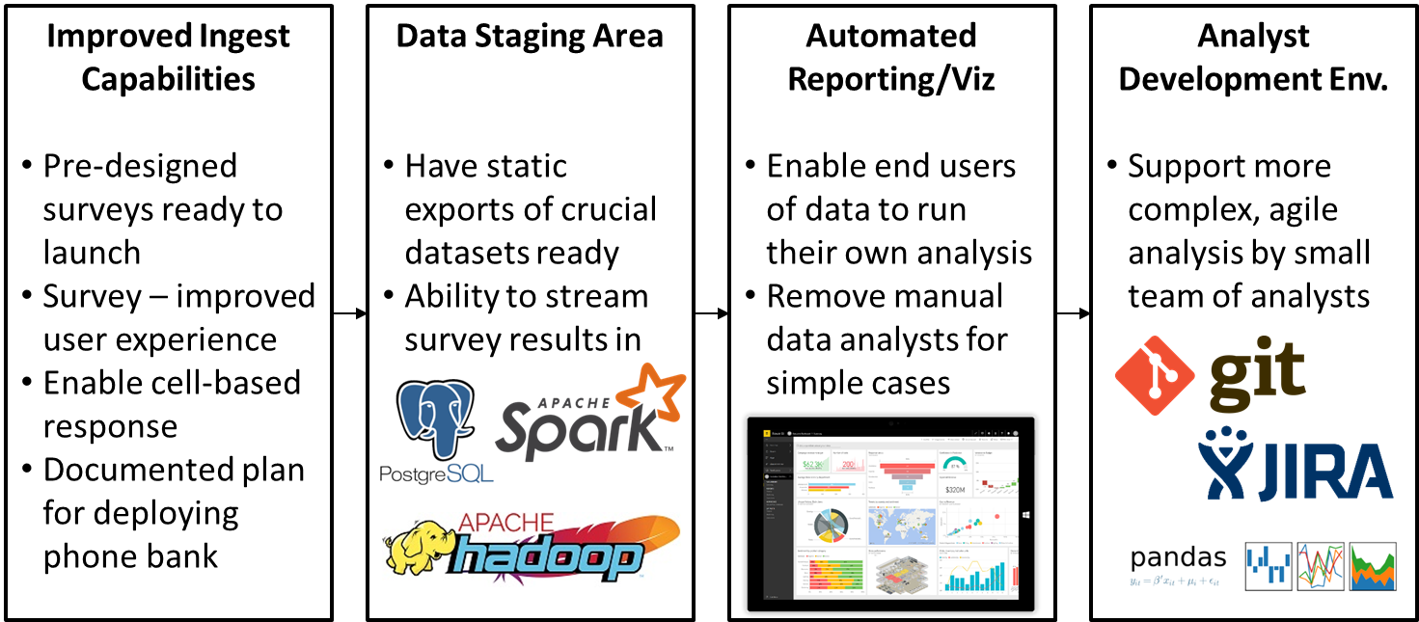
Leveraging Data Analytics and IT to Support
Rice University's Culture of Care During Hurricane Harvey
Max Grossman, Joshua Tootoo, Claire Osgood, Alex Hayes, Rushi Bhalani,
Spencer Chang, Napas Udomsak, Marie Lynn Miranda
Rice University
Hurricane Harvey
Category 4 hurricane
Up to 132 MPH winds
> 44 inches of rainfall (more than all of 2014)
The Data
Non-existent analytics/visualization capability
Many useful static datasets, but siloed
BANNER: HR data on all Rice staff/students
Course Listing: info on all current courses, including # students enrolled and instructors
Student Housing: listing of all on-campus students
Analyses (cont’d)
Geospatial - Harvey impact closely tied to location, rapidly evolving situation
Childcare - Many Rice community members have children; school closings → childcare needs exploded.
Course Impact - which instructors had their ability to teach impacted?
AlertHouston
Voluntary Evacuation for Flooded Homes in West Houston.
From State Highway 6 to South Gessner
From Interstate Highway 10/Katy Freeway south to Briar Forest
How many total Rice community members in this spatially defined area: 160
How many have we heard from: 90
How many have we not heard from: 70
Primary dynamic data set: Needs Assessment Survey
Collected information on Harvey’s impact
Housing damage, vehicle damage, loss of power/internet, etc.
Point locations have been masked to prevent identification.
Impact on Rice/Houston Community
High variation in impact motivates fine grain data collection and analysis
For some, little or no impact
For others, complete loss of home, vehicle, property, etc.
Rice University Culture of Care - we are responsible to and support our community
How can information technology, advanced education, and data analytics support a Culture of Care during a natural disaster?
Analyses
Response Rate - key to accurate planning, who is not responding? How can we reach them?
Loss of Housing - analysis showed many in Rice community saw significant flood damage
Lessons Learned
Central data gathering, local action effective way to implement disaster relief.
Achieving high response rates crucial to effective response planning – requires active engagement.
Feedback loop to communication, services, and policy important for sense of community.
Value of information decreases with age; current infrastructure is not ready for real time, rapid response to natural/manmade disasters – too much manual intervention required between data ingest and knowledge/wisdom development.
Harvey Analytics Response Team (HART)
Ad-hoc analytics capability created immediately post-Harvey to support Rice’s disaster response
People and software
Four undergrads, one postdoc, two research scientists, one Provost
R, Python, Box, Pandas, Slack, matplotlib
Response rate by reporting unit over time
Geographic distribution of responses
Proposed Future Infrastructure

